Slide 1


SAP UI5 & FIORI
Application Best Practices
www.zarantech.com
© Copyright 2021, ZaranTech LLC. All rights reserved.

Slide 2

Disclaimer
2
This presentation, including examples, images, and references are provided for informational purposes only.
Complying with all applicable copyrights laws is the responsibility of the user.
Without limiting the rights under copyright, no part of this document may be reproduced, stored or introduced into a retrieval system, or transmitted in any form or by any means.
Credits shall be given to the images taken from the open-source and cannot be used for promotional activities.
© Copyright 2021, ZaranTech LLC. All rights reserved.

Slide 3
Agenda
3
Preparing
Building

Slide 4
Preparing
2
Start with a high level overview of the aspects of UI5 development.
Understanding aspects of an enterprise scale application.
Each aspect is described here in terms of functionality.
‹#›
© Copyright 2021, ZaranTech LLC. All rights reserved.

Slide 5
Preparing
2
Approach
Definition of an App
Independent
Addressable
UI-Focused
Responsive
Accessible
Translateable
Maintainable
‹#›
© Copyright 2021, ZaranTech LLC. All rights reserved.

Slide 6
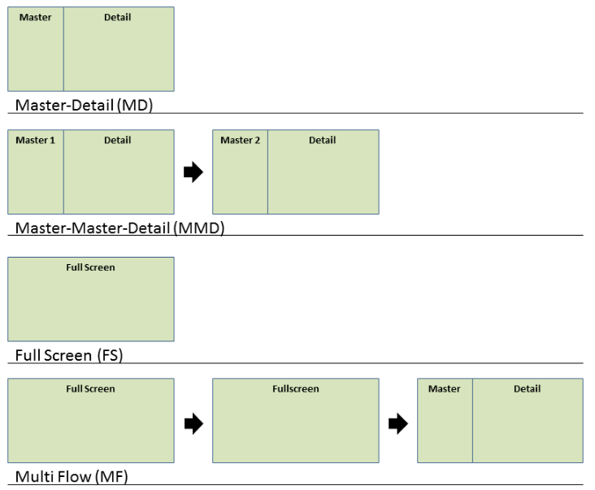
Preparing
2
Design Pattern
‹#›
© Copyright 2021, ZaranTech LLC. All rights reserved.

Slide 7
Preparing
2
Design Patterns
Master-Detail
Master-Master-Detail
Full Screen
Multi Flow
‹#›
© Copyright 2021, ZaranTech LLC. All rights reserved.

Slide 8
Preparing
2
Business Scenario
The Northwind Service
Functionality
‹#›
© Copyright 2021, ZaranTech LLC. All rights reserved.

Slide 9
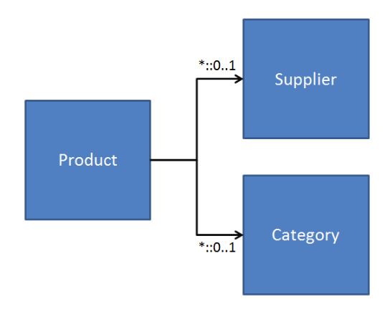
Preparing
2
The Northwind Service
‹#›
© Copyright 2021, ZaranTech LLC. All rights reserved.

Slide 10
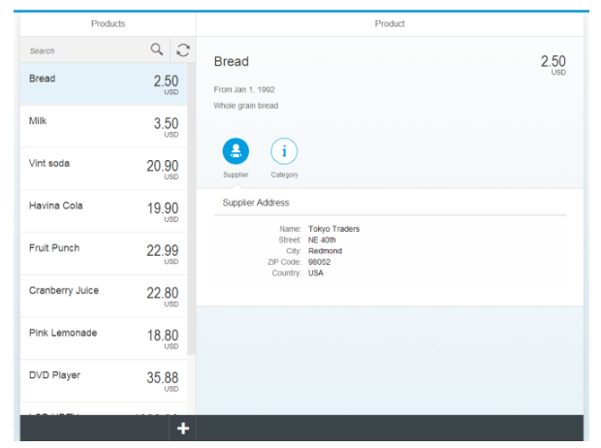
Building
2
App Overview and Structure
11
© Copyright 2021, ZaranTech LLC. All rights reserved.

Slide 11
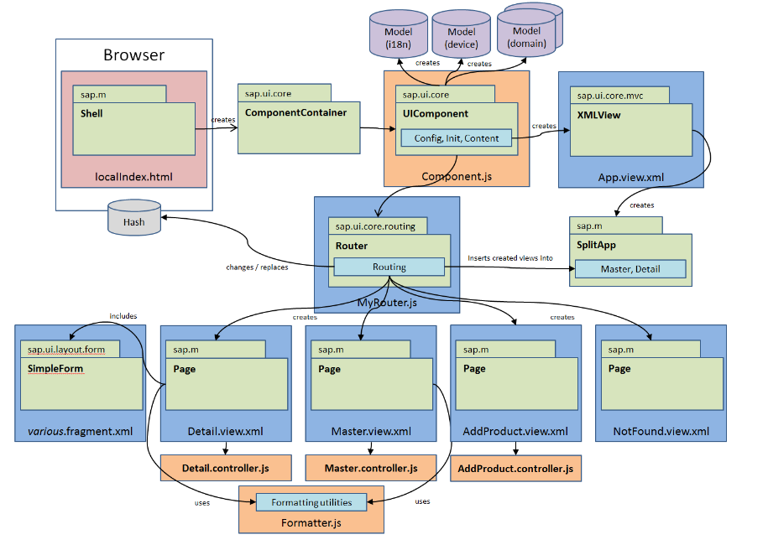
Building
2
App Overview and Structure
‹#›
© Copyright 2021, ZaranTech LLC. All rights reserved.

Slide 12
Building
2
What our app should consist of?
Index, Component and Message Bundle
The Views and Fragments
Other Files
The Overall Folder Structure
‹#›
© Copyright 2021, ZaranTech LLC. All rights reserved.

Slide 13
Thank you
Subscribe to our Channel for more Informative Videos.
https://www.youtube.com/user/ZaranTech

